Slide 1


BUS 243
Lecture 7: Introduction to Neural Net

Slide 2

Review Homework 3
Part I
What is an announcement effect?
Let’s consider Robinhood app
Why not in 10-K?
Information need in 10-K?
Query?

Slide 3
Yelp data analysis
Original data contains 7M observations
The given data is 1,000 sample
Any model should fail
Sampling, of course: 0.01 % data
Why?
Textual data needs large data
Why?

Slide 4
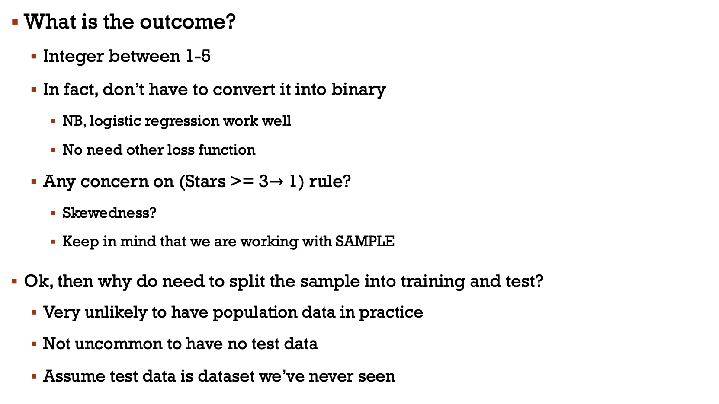
What is the outcome?
Integer between 1-5
In fact, don’t have to convert it into binary
NB, logistic regression work well
No need other loss function
Any concern on (Stars >= 3$→$ 1) rule?
Skewedness?
Keep in mind that we are working with SAMPLE
Ok, then why do need to split the sample into training and test?
Very unlikely to have population data in practice
Not uncommon to have no test data
Assume test data is dataset we’ve never seen

Slide 5
Normalization?
When do we need normalization?
Consider the workflow when modeling NB
First, we need to define the vocabulary
Tokenize every single sentence and collect the unique token from the Training data
Why do we need to think about the size of vocabulary?
Consider how to treat the tokens not used in test data
See the most frequent words in the longest sentence: stopping words
Understand well without them in the reviews
Tense mattered here?
Plural terms?
Unique words such as the name of POI would be a problem. But not many…

Slide 6
Naïve Bayes vs. Logistic regression
We learned that Naïve Bayes is the least preferred, but most evaluation metric showed the opposite
Mathematically, it is quite obvious
Too limited observations compared to the number of features
Most features are weak
Why this is the problem?
How about hand-written rules? Why does it look the least preferred?
Model is wrong (rule is wrong)
Even assuming the model is correct, feature has measurement error

Slide 7
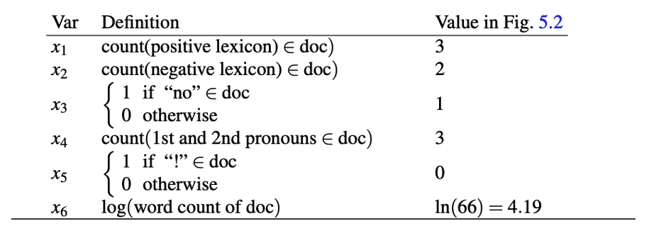
Let’s think about two cases
Complete list of pos and neg words
Train the model with population data

Slide 8
Neural Net Frenzy
You may hear “AI, Deep learning, Neural net” almost everywhere
Why?
Is it better than any type of traditional approach?
Neural Net is just a class of models
Input, output, and parameters
Ok, a lot of parameters…

Slide 9
Neural net vs. logistic regression
Experience and domain knowledge are essential for effective feature engineering
Labor intensive approach

Slide 10
What is a better model?

Slide 11

By BruceBlaus - Own work, CC BY 3.0, https://commons.wikimedia.org/w/index.php?curid=28761830
Notes:
Neural networks are called neural because their origins lie in the McCulloch-Pitts neuron, which was a 1943 simplified model of the human neuron as a kind of computing element that could be described in terms of propositional logic. But the modern use in language processing no longer draws on these early biological inspirations and the name neural is really just a kind of historical remnant.

Slide 12
Output value
Non-linear transform
Weighted sum
bias
Weights
Input layer
Notes:
Instead, a modern neural network is a network of small computing units, each of which takes a vector of input values and produces a single output value.
Over the next few lectures we'll introduce these units and see how they connect together into feedforward networks, so called because the computation proceeds iteratively from one layer of units to the next. The use of modern neural nets is often called deep learning, because modern networks are often deep (have many layers).
The building block of a neural network is a single computational unit. A unit takes a set of real valued numbers as input, performs some computation on them (combining with weights and biases and a non-linear transform), and produces an output. Let's see this in more detail.

Slide 13
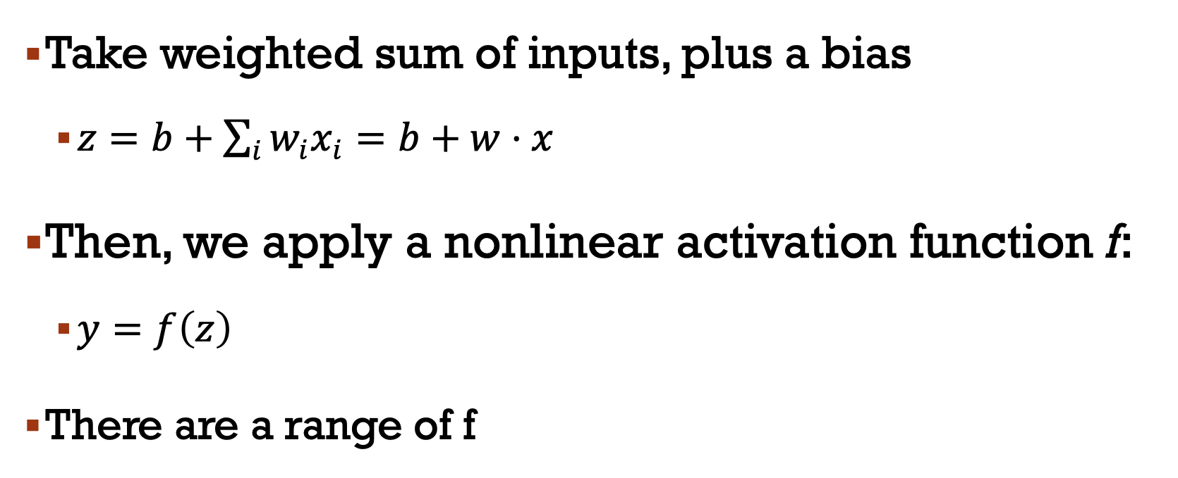
A neural unit
Take weighted sum of inputs, plus a bias
$z=b+\sum_{i}{w_{i}x_{i}}=b+w⋅x$
Then, we apply a nonlinear activation function f:
$y=f\left(z\right)$
There are a range of f

Slide 14
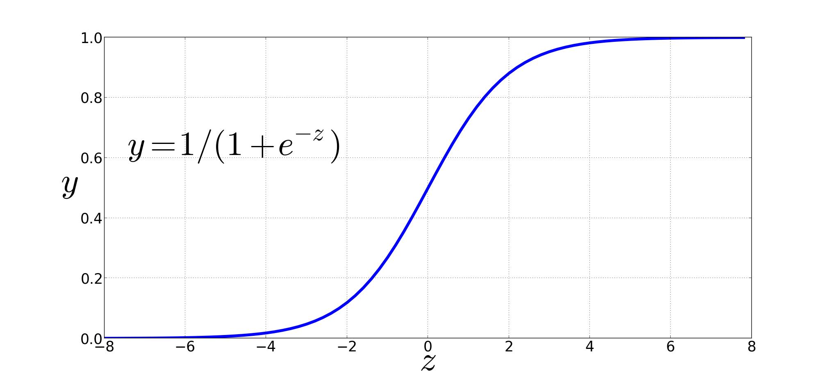
Non-Linear Activation Functions
Sigmoid
Notes:
We're already seen the sigmoid for logistic regression: 1 over 1 plus exp (-z).
The sigmoid has a number of advantages; it maps the output into the range [0,1], which is useful in squashing outliers toward 0 or 1. And it’s differentiable, which as we saw is handy for learning

Slide 15
Final function the unit is computing
Notes:
So here's the function that a simple unit with a sigmoid activation function is computing from an input x, a weight vector w, and a bias term b

Slide 16
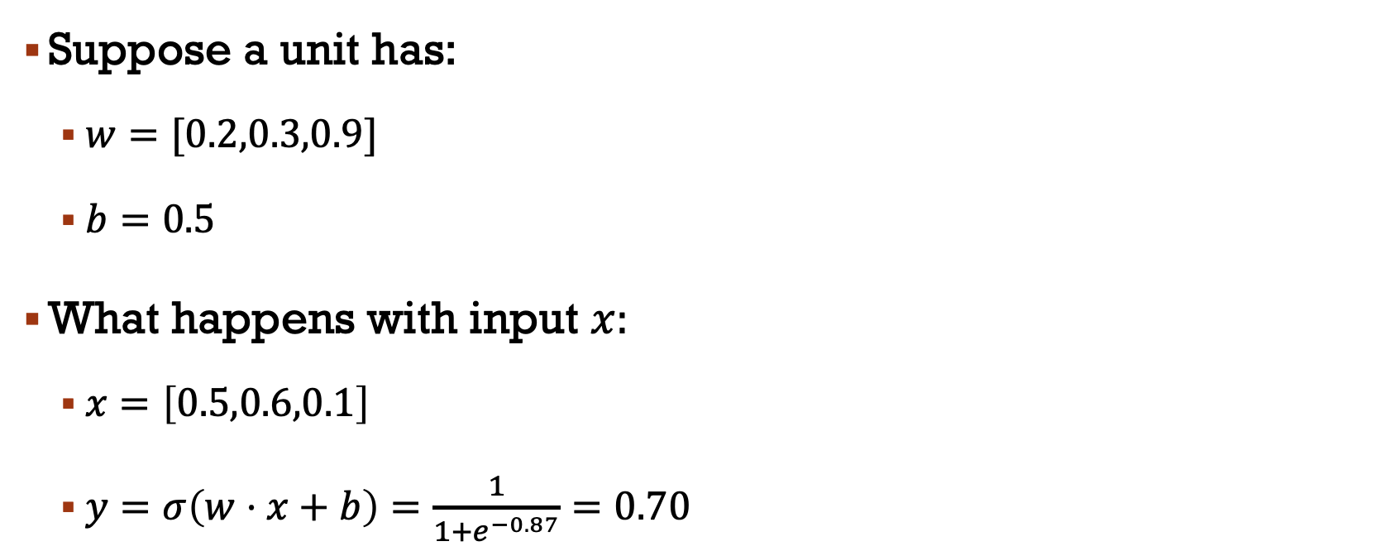
example
Suppose a unit has:
$w=[0.2,0.3,0.9]$
$b=0.5$
What happens with input $x:$
$x=\left[0.5,0.6,0.1\right]$
$y=σ\left(w⋅x+b\right)=\frac{1}{1+e^{−0.87}}=0.70$

Slide 17
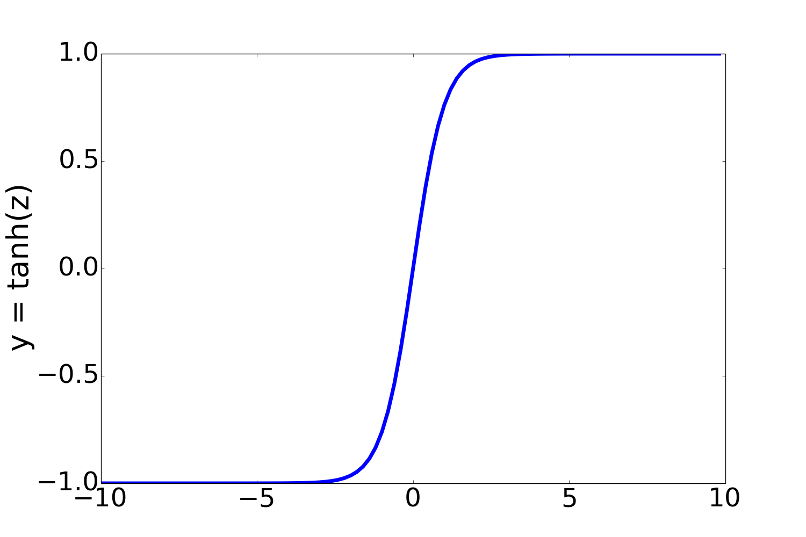
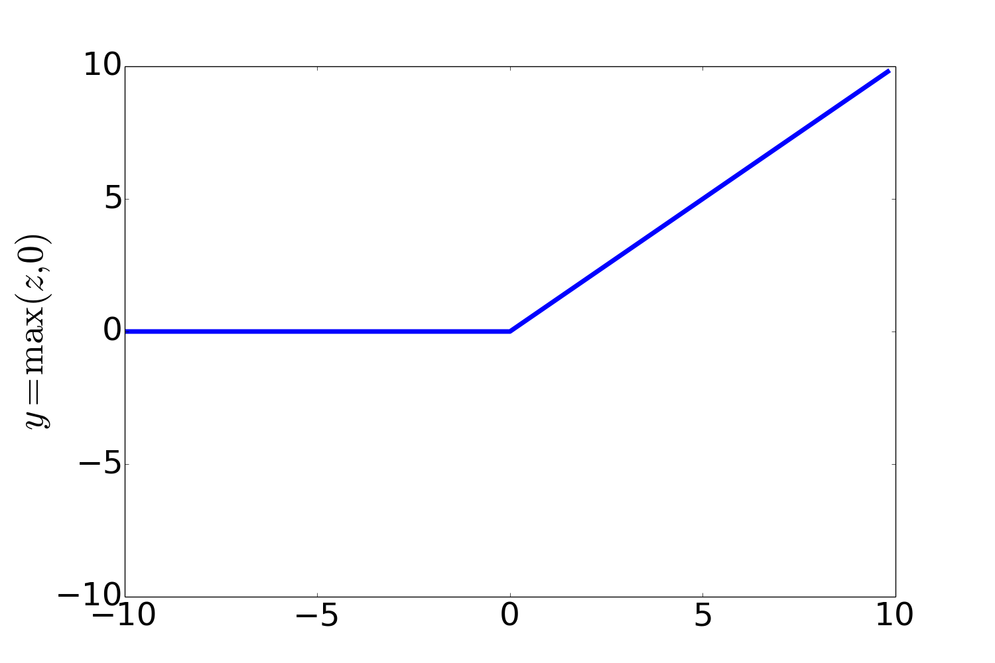
Other Non-Linear Activation Functions
Most Common:
ReLU
Rectified Linear Unit
tanh
Notes:
In practice, the sigmoid is not commonly used as an activation function. A function that is very similar but almost always better is the tanh function; tanh is a variant of the sigmoid that ranges from -1 to +1:
The tanh function has the nice properties of being smoothly differentiable and mapping outlier values toward the mean.
The simplest activation function, and perhaps the most commonly used, is the rectified linear unit, also called the ReLU,. It’s just the same as z
when z is positive, and 0 otherwise:
The Rectified Linear Unit function, has nice properties that result from it being very close to linear. In the sigmoid or tanh functions, very high values of z result in values of y that are saturated, i.e., extremely close to 1 and have derivatives very close to 0. Zero derivatives cause problems for learning: gradients that are almost 0 cause the error signal to get smaller and smaller until it is too small to be used for training, a problem called the vanishing gradient problem. Rectifiers don’t have this problem, since the derivative of ReLU for high values of z is 1 rather than very close to 0.

Slide 18
Activation functions
Each functions have different properties
The tanh() is smoothly differentiable and maps outliers toward the mean
Preferred to the sigmoid
ReLU produces linear-like results
The choice of activation function can indeed be influenced by the tasks the neural network is designed to perform
But no linear activation function!

Slide 19
Multilayer networks
The strength of neural networks lies in their ability to combine individual units into larger networks
Called multi-layer networks (rarely used)
Linear models including a single neural unit cannot compute XOR problmes

Slide 20
Perceptron
Consider the perceptron, a very simple neural unit that has a binary output with a step activation function
Easy to build AND or OR with perceptrons

Slide 23
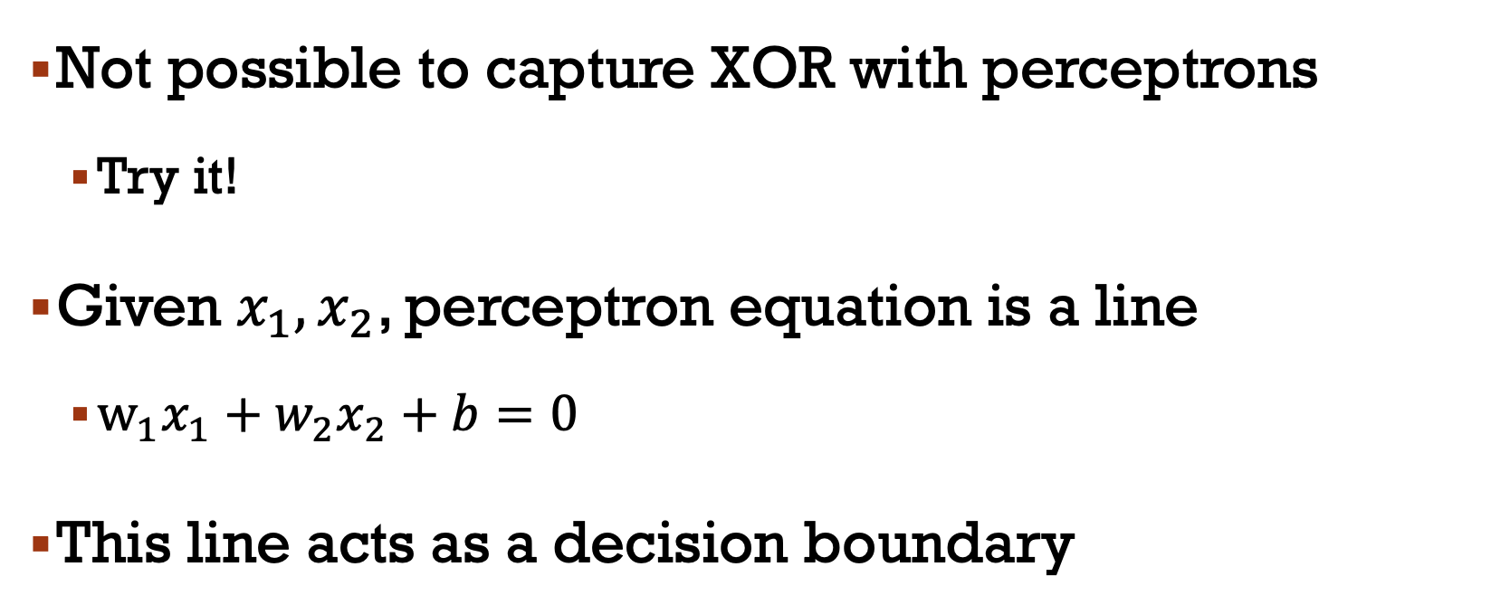
XOR problem
Not possible to capture XOR with perceptrons
Try it!
Given $x_{1},x_{2}$, perceptron equation is a line
$w_{1}x_{1}+w_{2}x_{2}+b=0$
This line acts as a decision boundary

Slide 24
Decision boundaries
XOR is not linearly separable function

Slide 25
Solution to the XOR problem
XOR can’t be calculated by a single perceptron
XOR can be calculated by a layered network of units
ReLU
ReLU

Slide 26
We can view the hidden layer of the network as forming a representation of the input
The hidden layers will learn to form useful representations

Slide 27
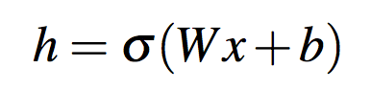
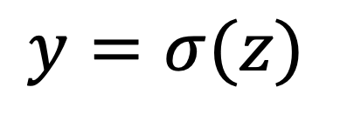
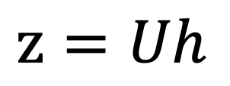
Output layer
(σ node)
$$y=σ(z)$$
$$z=Uh$$
U
hidden units
(σ node)
W
b
Input layer
(vector)
x₁
x_{n}
+1
Notes:
Here are the final equations for a feedforward network with a single hidden layer, which takes an input vector x, outputs a probability distribution y, and is parameterized by weight matrices W and U and a bias vector b:

Slide 28
Feedforward neural Networks
The feedforward network is the simplest NN
Fully connected with no cycles
Minimum requirement: input units, hidden units, output units
Layers, nodes, units used interchangeably
The core is the hidden layer

Slide 29
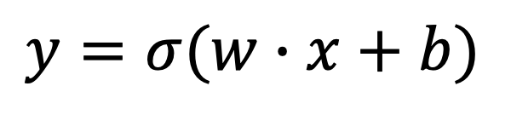
Binary Logistic Regression as a 1-layer Network
(we don't count the input layer in counting layers!)
σ
$$y=σ(w∙x+b)$$
Output layer
(σ node)
(y is a scalar)
w
w₁
w_{n}
b
(scalar)
(vector)
Input layer
vector x
x₁
x_{n}
+1
Notes:
Let's go back to logistic regression. We can think of binary logistic regression as a 1-layer network (we don't count the input layer in counting layers!). So we have an input layer we could call layer 0 consisting of a vector x, we multiply x b a weight matrix, add a scalar bias, and then the 1st layer, the output layer computes a a scalar y as a sigmoid of w dot x + b.

Slide 30
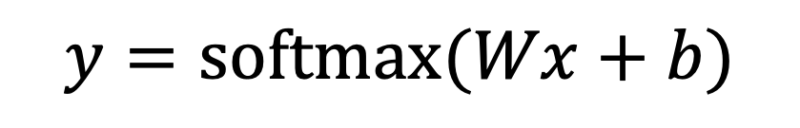
Multinomial Logistic Regression as a 1-layer Network
Fully connected single layer network
y₁
y_{n}
s
s
s
$$y=\text{softmax}(Wx+b)$$
Output layer
(softmax nodes)
y is a vector
W
b
W is a matrix
b is a vector
Input layer
scalars
x₁
x_{n}
+1
Notes:
Remember multinomial Logistic Regression, where instead of a single sigmoid at the output, we have a softmax to turn the output values into probabilities

Slide 31
softmax: a generalization of sigmoid
For a vector z of dimensionality k, the softmax is:
Example:

Slide 32
Two-Layer Network with scalar output
$$y=σ(z)$$
y is a scalar
Output layer
(σ node)
$$z=Uh$$
U
hidden units
(σ node)
Could be ReLU
Or tanh
W
b
Input layer
(vector)
x₁
x_{n}
+1
Notes:
Here are the final equations for a feedforward network with a single hidden layer, which takes an input vector x, outputs a probability distribution y, and is parameterized by weight matrices W and U and a bias vector b:

Slide 33
Two-Layer Network with scalar output
$$y=σ(z)$$
y is a scalar
Output layer
(σ node)
$$z=Uh$$
U
hidden units
(σ node)
j
W_{ji}
W
b
vector
Input layer
(vector)
x₁
i
x_{n}
+1
Notes:
Each element Wji of the weight matrix W represents the weight of the connection from the ith input unit xi to the jth hidden unit hj.

Slide 34
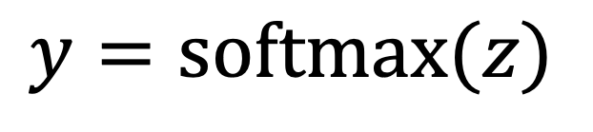
Two-Layer Network with softmax output
Output layer
(σ node)
$$y=\text{softmax}(z)$$
$$z=Uh$$
U
y is a vector
hidden units
(σ node)
Could be ReLU
Or tanh
W
b
Input layer
(vector)
x₁
x_{n}
+1
Notes:
What if you have more than two output classes?
If we are doing multinomial classification, such as assigning a part-of-speech tag, we just add more output units (one for each class).
So we might have one output node for each potential part-of-speech, whose output value is the probability of that part-of-speech,
The output layer thus gives a probability distribution across the output nodes. We use the softmax to compute this distribution, just as for multinomial logistic regression
That means we can think of a neural network classifier with one hidden layer as building a vector h which is a hidden layer representation of the input, and then running standard logistic regression on the features that the network develops in h. By contrast, in Chapter 5 the features were mainly designed by hand via feature templates. So a neural network is like logistic regression, but (a) with many layers, since a deep neural network is like layer after layer of logistic regression classifiers, and (b) rather than forming the features by feature templates, the prior layers of the network induce the feature representations themselves.

Slide 35
Feedforward neural Networks
The resulting value h forms a representation of the input
The role of the output layer is to take this new representation h and compute a final output

Slide 36
Classification: Sentiment analysis
Consider what we did for logistic regression

Slide 37
Feedforward nets for simple classification
σ
U
σ
2-layer
feedforward
network
Logistic
Regression
W
W
x₁
x_{n}
f₁
f_{n}
x₁
x_{n}
f₂
f₁
f₂
f_{n}
Just adding a hidden layer to logistic regression
Allow the the network to use non-linear interactions between features
Logistic regression assume features are independent
May or may not to improve performance
37

Slide 38
Even better: representation learning
The real power of deep learning comes from the ability to learn features from the data
Instead of using hand-built features
Use the word embeddings

Slide 39
Neural Net Classification with embeddings as input features!

Slide 40
This assumes a fixed size length (3), which is unrealistic
Some solutions
Fix the input sentence size
If shorter, then pad with zero embeddings
Truncate if you get longer reviews at test time
Create a single “sentence embedding” to represent all the words in each sentence
Take the mean of all the word embedding
Take the element-wise max of all the word embeddings

Slide 41
Backpropagation
For many years, researchers struggled to find a way to train NN
Gradient descent was the potential candidate, but it requires computing the gradients of the model’s error with regard to the parameters
Not clear at the time how to do this efficiently with such a complex model containing so many parameters
In 1970, Linnainmaa proposed the reverse-mode autodiff
In just two passes through the network, able to compute the gradients of the NN’s error with respect to every single model parameter

Slide 42
A mini-batch enters the network through the input layer
Compute the output of network through every layer: forward pass
All intermediate results are preserved
The algorithm computes the network’s output error through a loss
Then it computes how much each output bias and each connection to the output layer contributed to the error
Use chain rule
Then the algorithm measures how much of these error contributions came from each connection in the layer below, working backward until it reaches the input layer
Finally, the algorithm performs a gradient descent step to tweak all the connection weights in the network, using the error gradients it just computed.

Slide 43
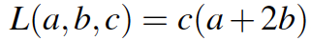
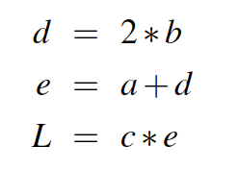
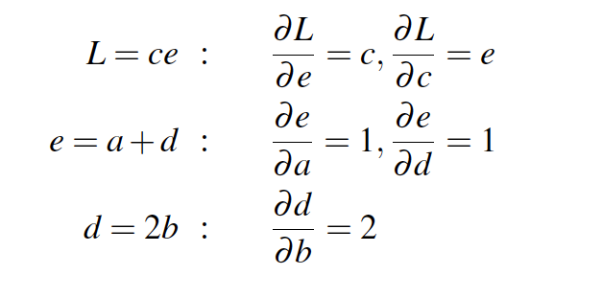
Notes:
Those equations, we've put them here on the top, thus require five intermediate derivatives: ∂L/∂e , ∂L/∂c , ∂e/∂a , ∂e/∂d , and ∂d/∂b , which are as follows (making use of the fact that the derivative of a sum is the sum
of the derivatives):

Slide 44
Notes:
In the backward pass, we compute each of these partials along each edge of the graph
from right to left, multiplying the necessary partials to result in the final derivative
we need. Thus we begin by annotating the final node with ∂ L/∂L = 1. Moving to the
left, we then compute ∂ L/ ∂c and ∂L/∂e , and so on, until we have annotated the graph all the way to the input variables. The forward pass conveniently already will have computed the values of the forward intermediate variables we need (like d and e) to compute these derivatives.

Slide 45
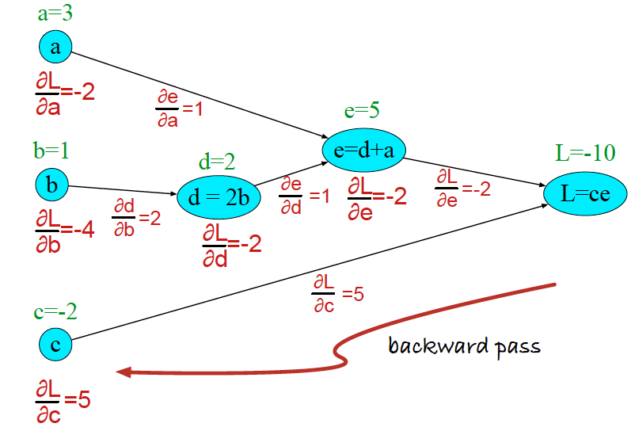
Notes:
n the backward pass, we compute each of these partials along each edge of the graph
from right to left, multiplying the necessary partials to result in the final derivative
we need.
At each node we need to compute the local partial derivative with respect to the parent, multiply it by the partial derivative that is being passed down from the parent, and then pass it to the child.
Thus we begin by annotating the final node with ∂ L/∂L = 1. Moving to the
left, we then compute ∂ L/ ∂c and ∂L/∂e , and so on, until we have annotated the graph all the way to the input variables. The forward pass conveniently already will have computed the values of the forward intermediate variables we need (like d and e) to compute these derivatives.

Slide 46
Summary: process
In short, backpropagation makes predictions for a mini-batch (forward pass),
measures the error, then goes through each layer in reverse to measure the error contribution from each parameter (reverse pass),
and finally tweaks the connection weights and biases to reduce the error (gradient descent step).

